Slide 1


CRISISKONNECT
Your helping hand in crisis

Slide 2
Developers of the Project
Sai Priya Veerabomma
Venkata Chaitanya Mandati
Siddhartha Ravilla
Venkat Akash Varun

Slide 3
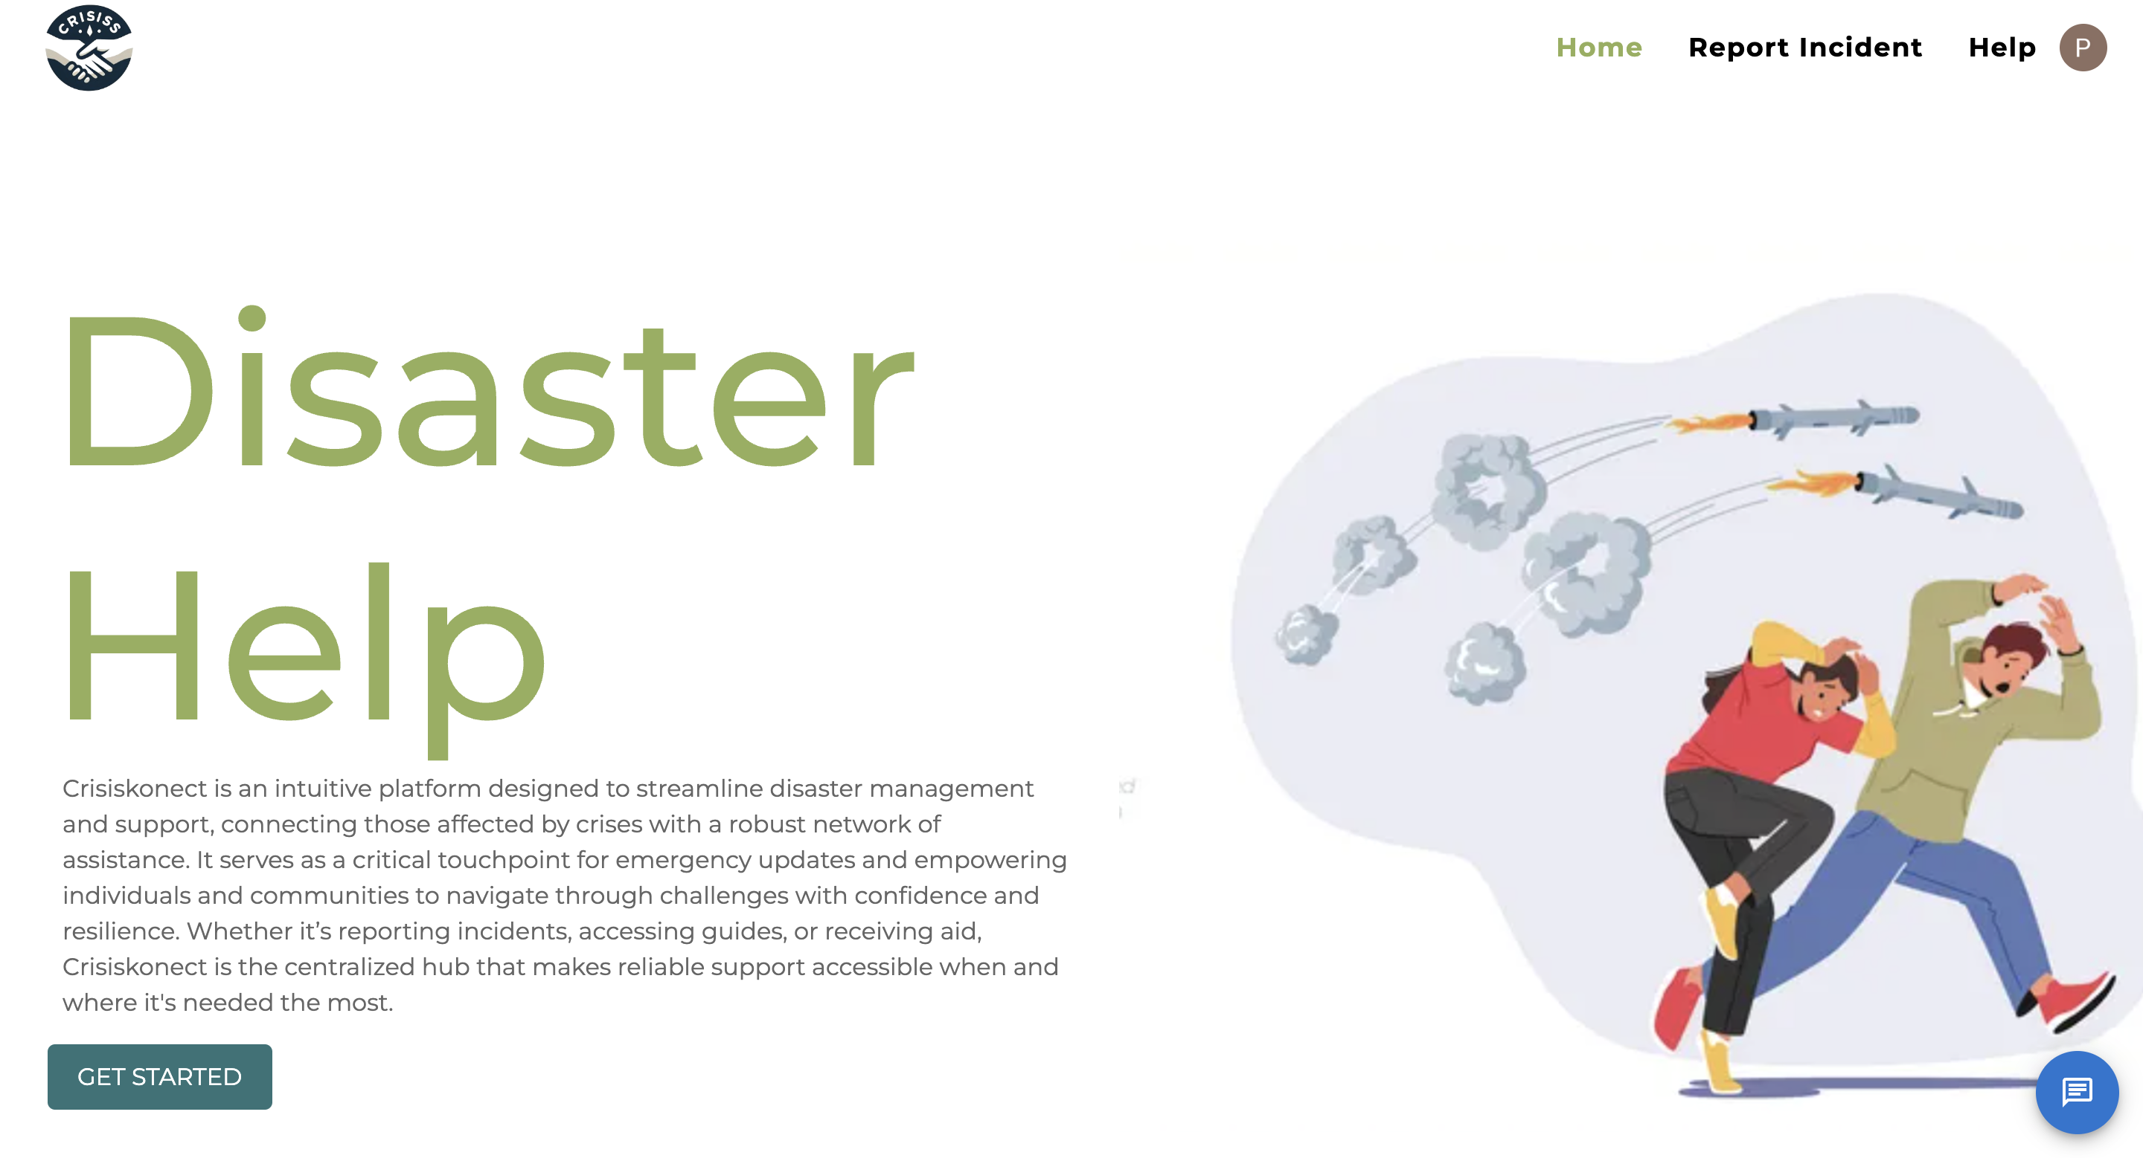
CRISISKONNECT is an intuitive platform designed to streamline disaster management and support, connecting those affected by crises with a robust network of assistance. It serves as a critical touchpoint for emergency updates and empowering individuals and communities to navigate through challenges with confidence and resilience. Whether it’s reporting incidents, accessing guides, or receiving aid, Crisiskonect is the centralized hub that makes reliable support accessible when and where it's needed the most.

Slide 4
Why Crisis connect?
Crisis Connect serves as a lifeline during emergencies, offering a centralized platform that links individuals and communities to essential resources and support. It's an empowering tool for real-time communication, providing guidance, assistance, and updates when they're needed most, ensuring that no one has to face a crisis alone.
Register
Report an incident
Look for a safe house
donate

Slide 5
API’s Implemented
Clerk
Stripe
OpenAI
Twilio, Nodemailer
GoogleMaps

Slide 6
Tech Stack
React
Node
Mongoose
Redux
Type Script
Boot Strap
Express

Slide 7
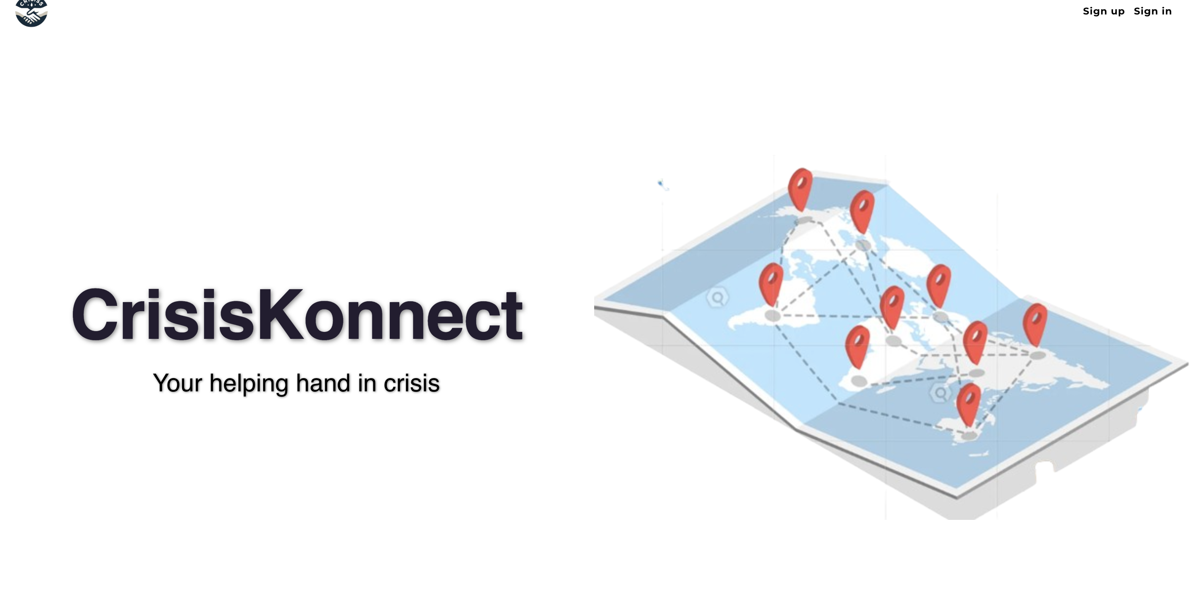
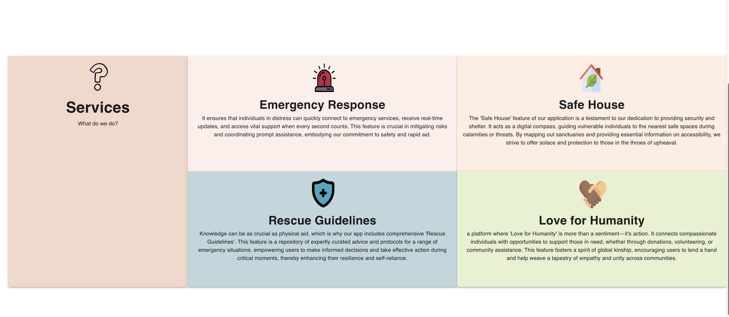
HOME PAGE

Slide 8
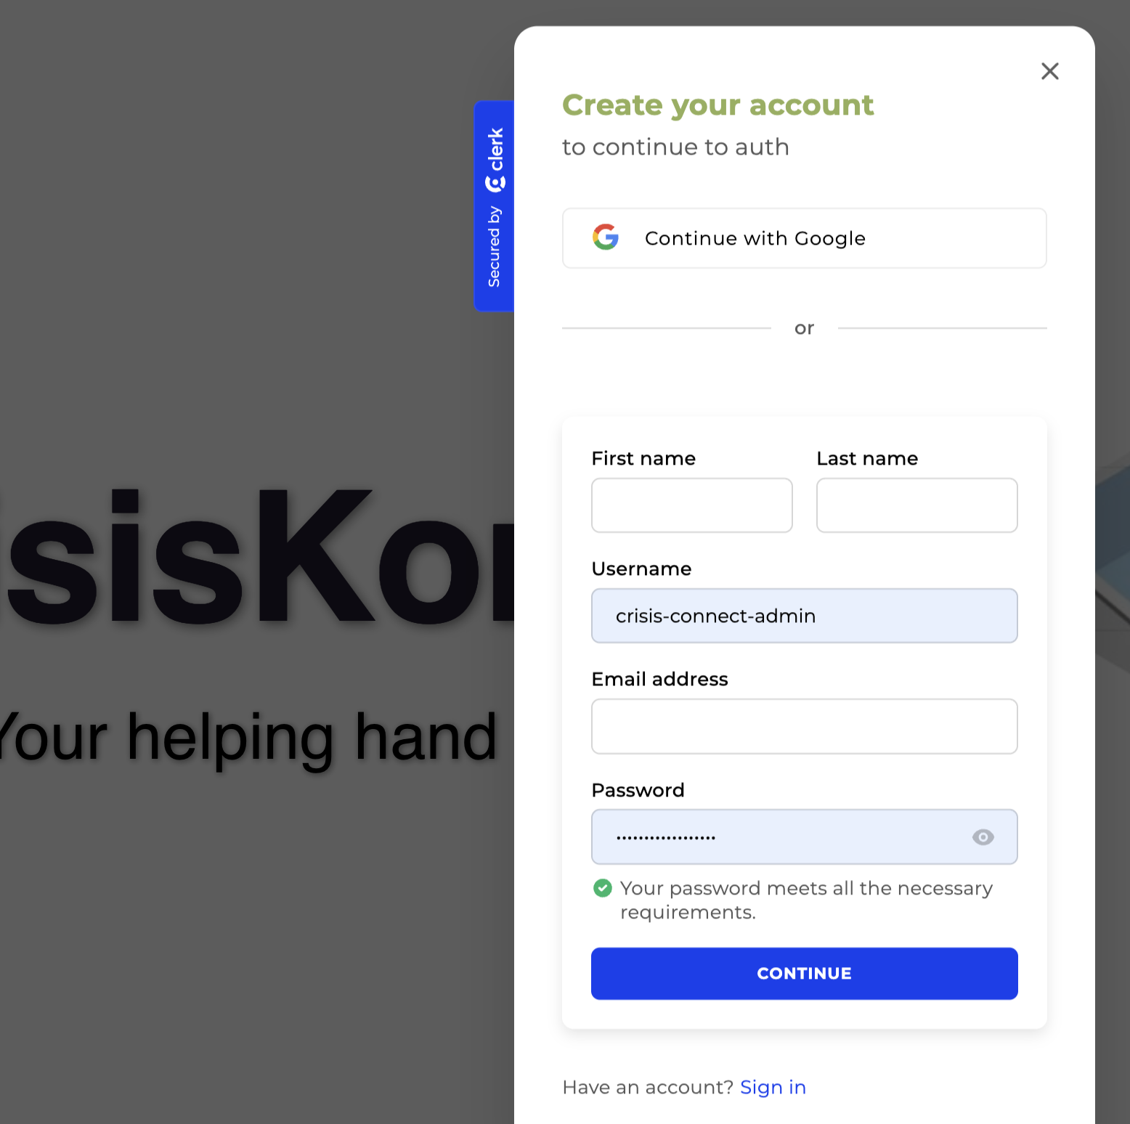
Sign-up Page to the website

Slide 9
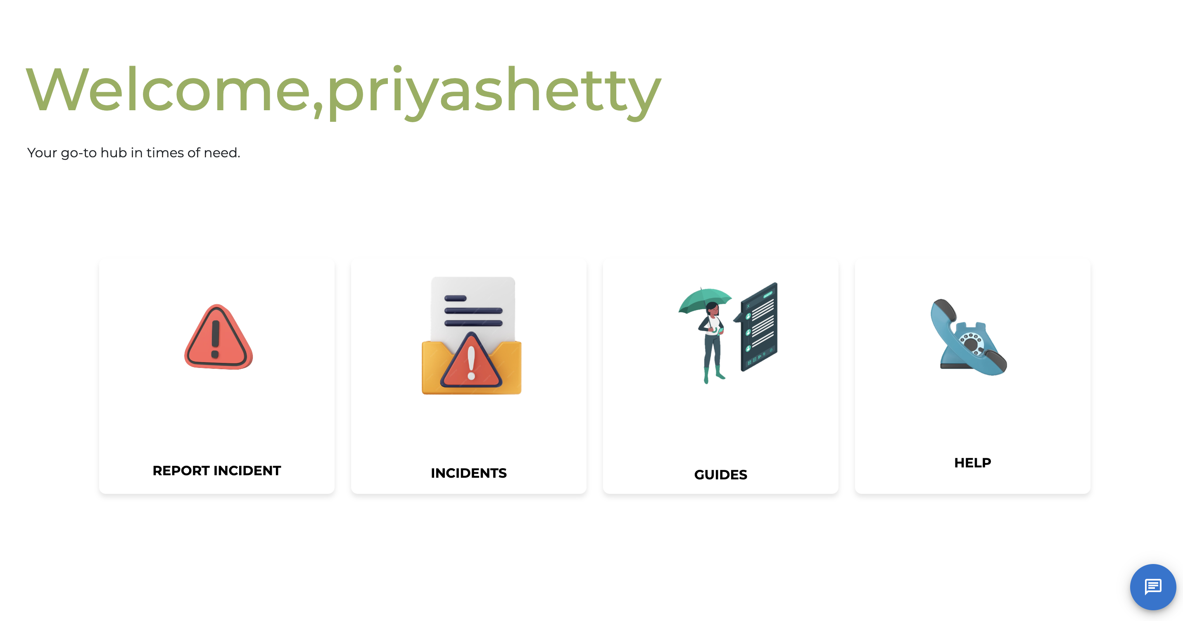
Home Page

Slide 10
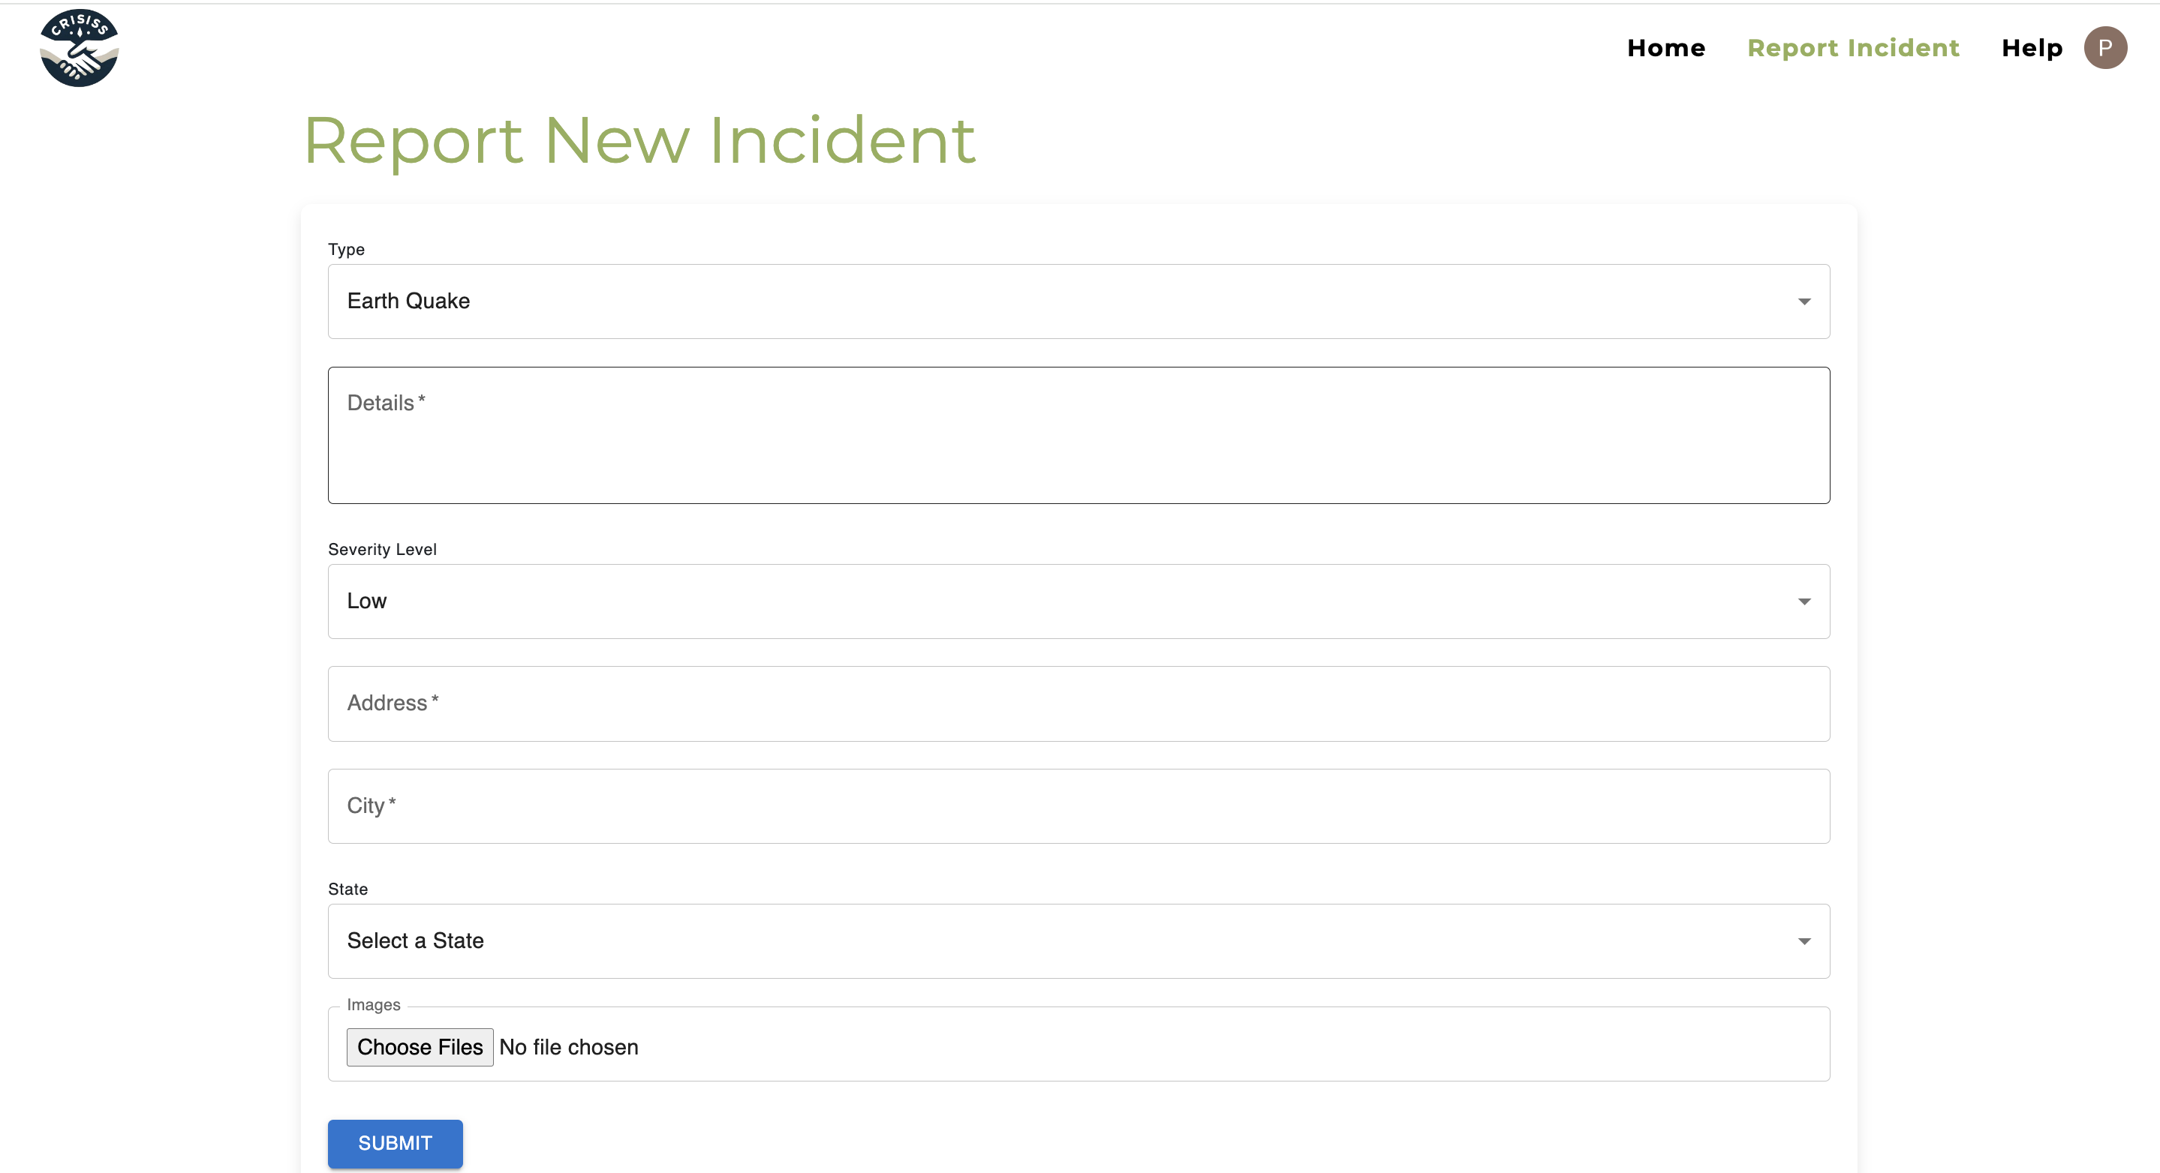
Incident Report Form

Slide 11
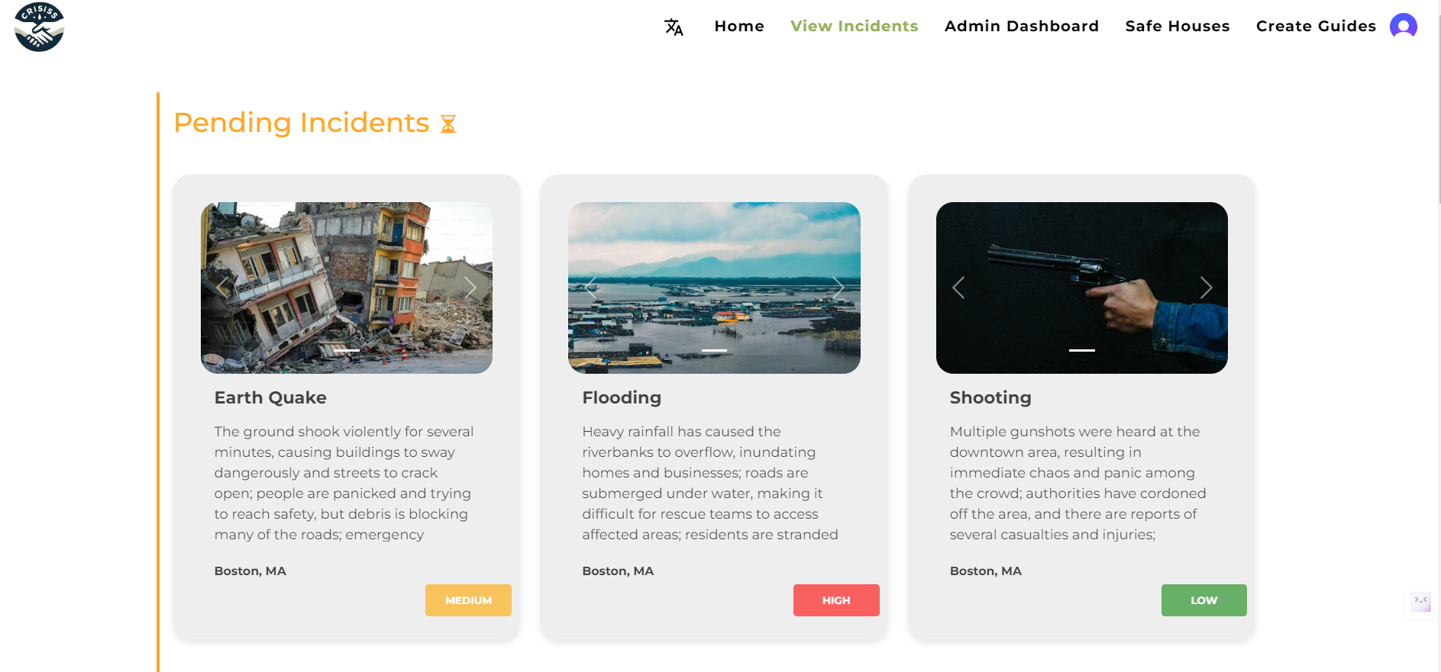
INCIDENTS SECTION

Slide 12
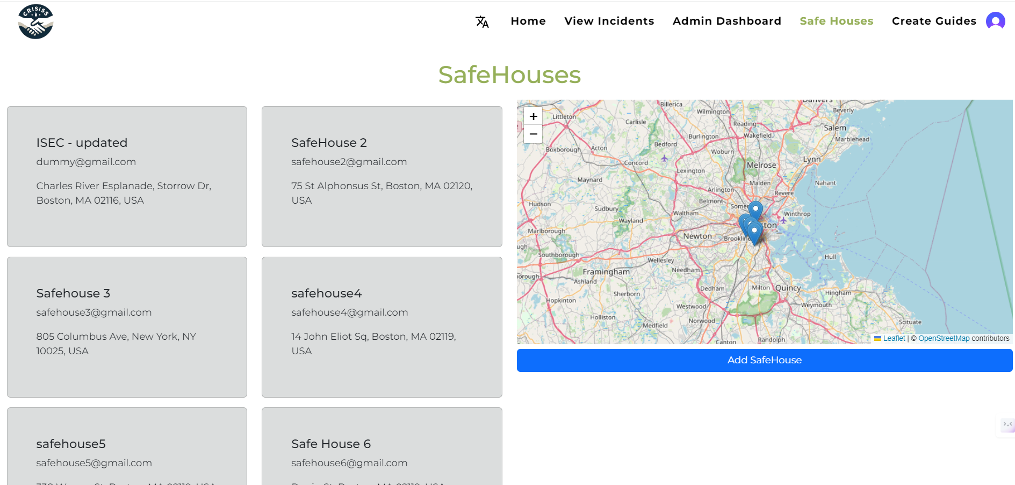
SAFE HOUSES LOCATION

Slide 13
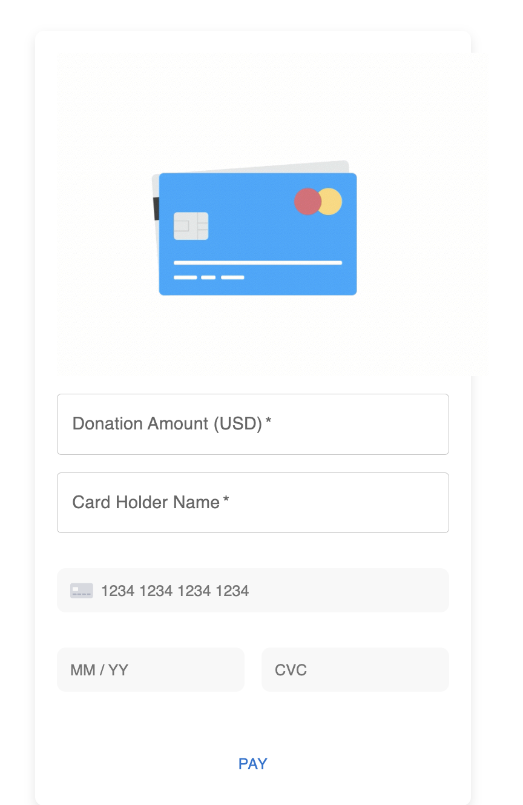

DONATE

Slide 14
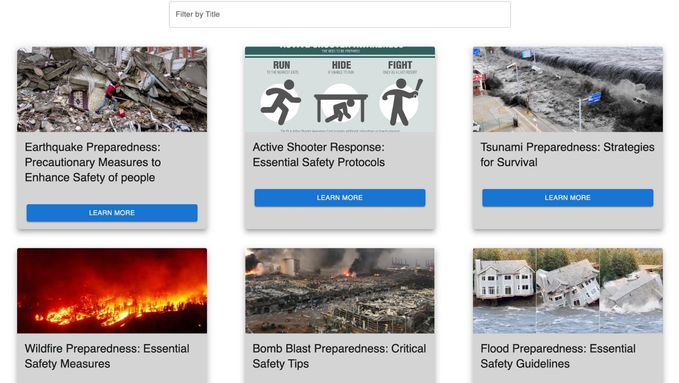
GUIDES

Slide 15
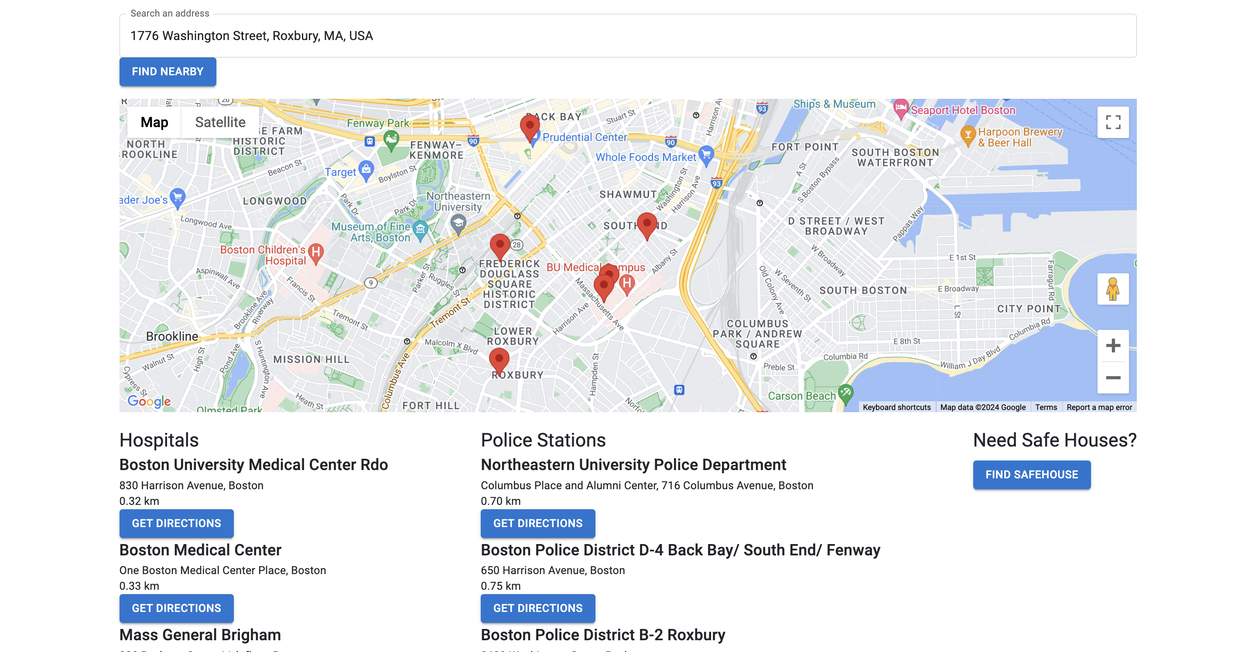
ASSISTANCE

Slide 16
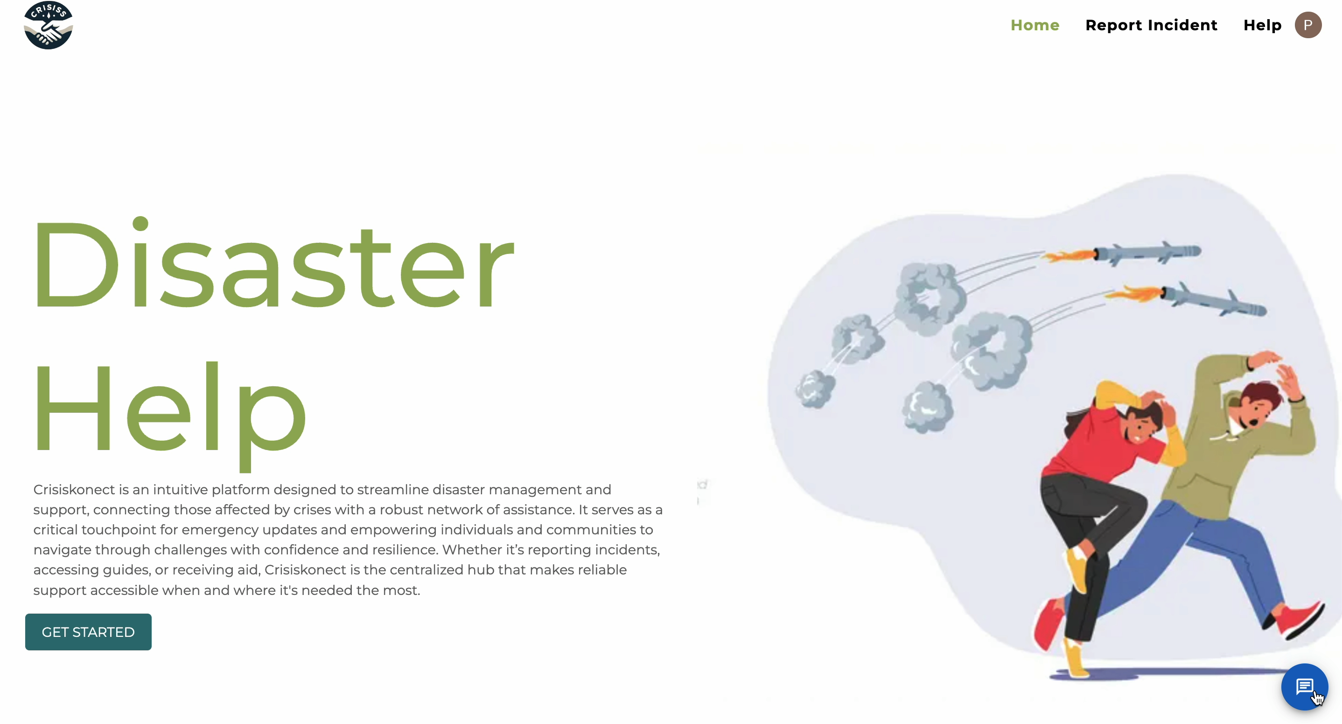
AI HELP ASSISTANT

Slide 17
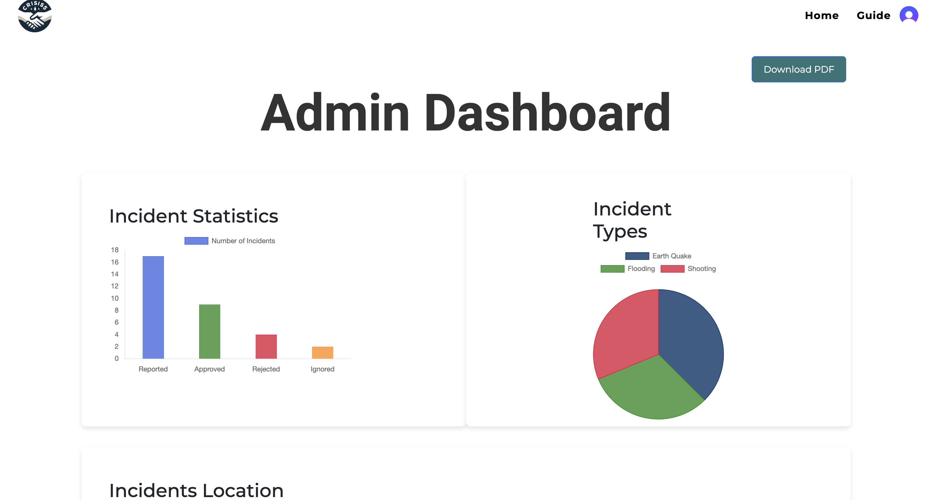
ADMIN DASHBOARD

Slide 18
Thank You

